Slide 1
Adverse outcome pathway Workshop
Co-instructed by:
Prof. Xiaowei Zhang (Nanjing University)
and
Dr. Carlie LaLone (U.S. Environmental Protection Agency)
10 June 2019

Slide 2
Workshop Schedule
09:00-09:30 Registration
09:30-10:45 Introduction to Adverse Outcome Pathways Part I
              A Pathway-based Approach to Toxicology
10:45-11:15 Coffee Break
11:15-12:30 Introduction to AOPs Part II
              Principles and Best Practices in AOP Development
12:30-14:00 Lunch
14:00-15:30 AOPs in Practice Part I – A tool to Crowd-Source Pathway Development and Applications
              Introduction to the AOP-Wiki
15:30-16:00 Coffee Break
16:00- 17:00 AOPs in Practice part II
              Principles to Practice: Hands-on Exploration of the AOP-Wiki
17:00-17:30 What’s Next: The Future of AOP Development and Sustainability of the Framework
17:30-19:30 ICMPE-9 Ice-breaking Reception

Slide 3
Introduction to AOPs Part I
A Pathway-based Approach to Toxicology

Slide 4
Why AOPs?

Slide 5

Paradigm Shift in Toxicology Testing
“Transform toxicity testing from a system based on whole-animal testing to one founded primarily on in vitro methods that evaluate changes in biologic processes using cells, cell lines, or cellular components, preferably of human origin”
“The vision emphasizes the development of suites of predictive, high-throughput assays …..”
“The mix of tests in the vision include tests that assess critical mechanistic endpoints involved in the induction of overt toxic effects rather than the effects themselves.”
US National Research Council, 2007

Slide 6
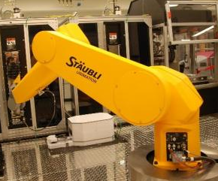
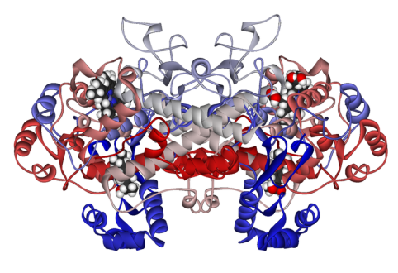
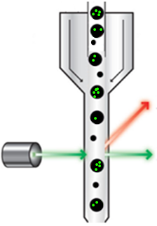

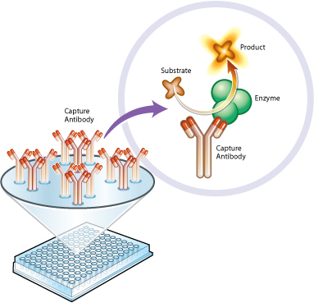
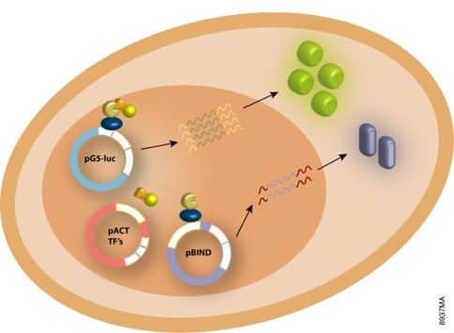
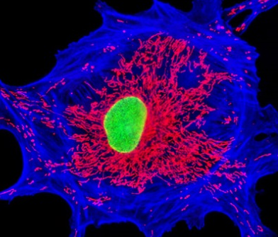

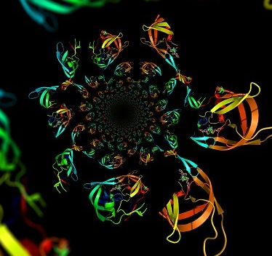


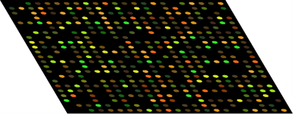
Mechanistic Endpoints
Genomics
Proteomics
Metabolomics
Bioinformatics
High Throughput + High content → Big Data!
Notes:
HUNDREDS in vitro assays in multi-well plates generating data for ~1 million samples per week
Coupled to “omics” technologies

Slide 7
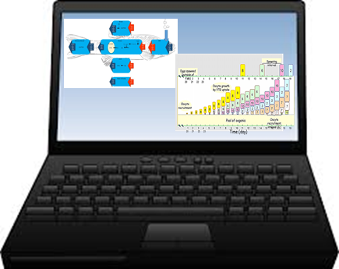
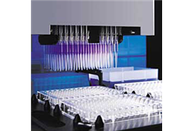

Can generate mechanistic data on an unprecedented scale
Can store, process, analyze and share those data

Slide 8

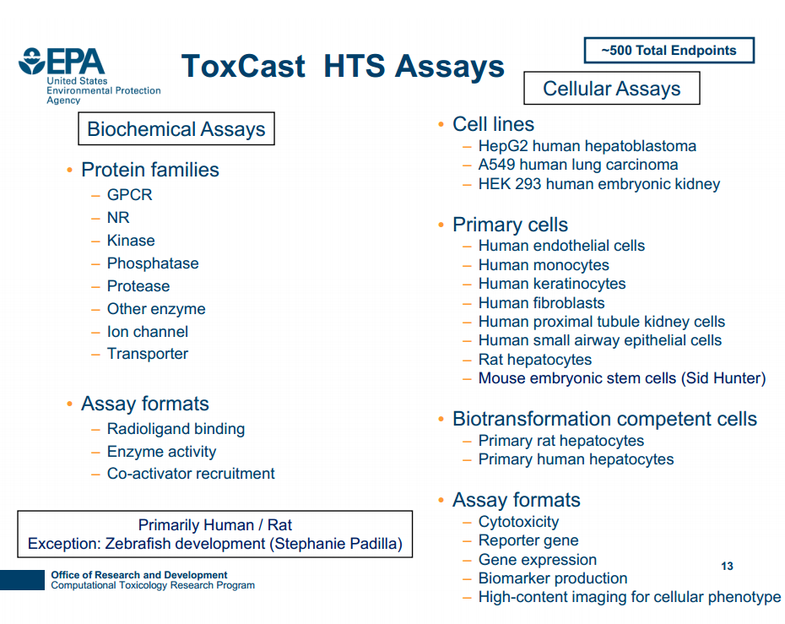
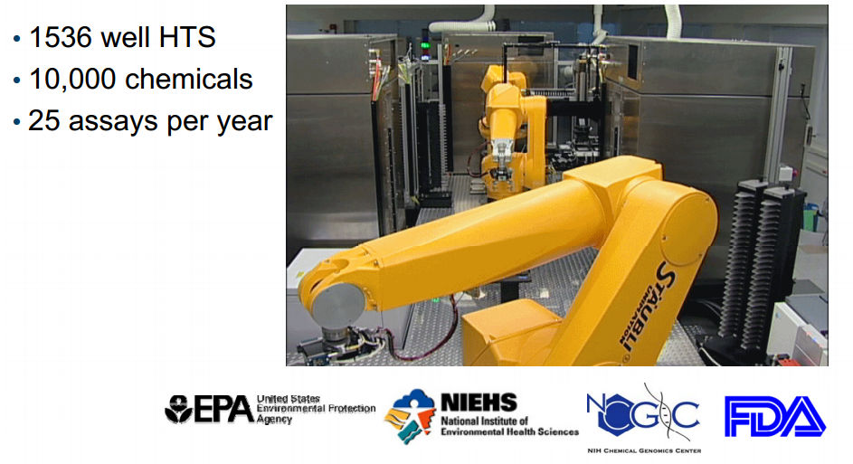
Introduction
ToxCast
> 600 assays, >3000 chemicals,

Slide 9
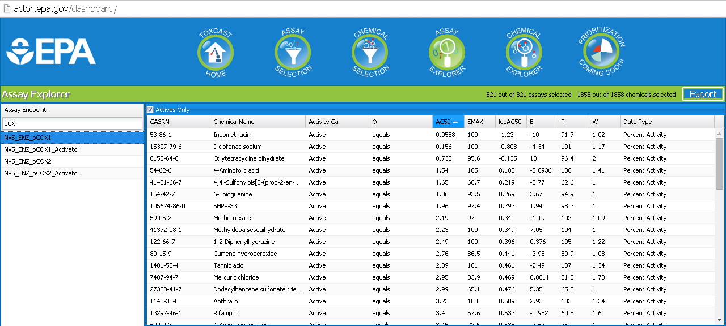

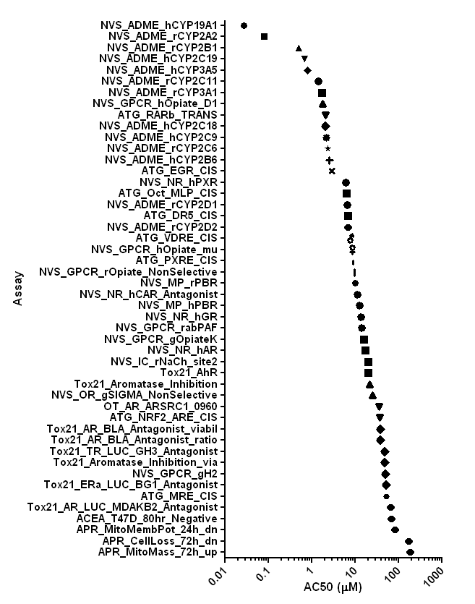
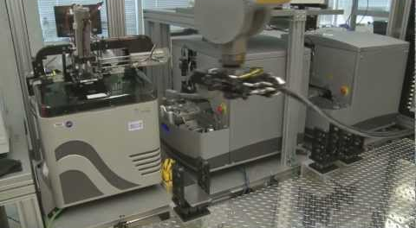
Toxicity Testing in the 21st Century
21st Century Toxicity Testing is here….
We can rapidly and cost effectively generate pathway-based data
  Activity of 1000s of chemicals in 100s of pathways.
Conceivable that majority of chemicals in commerce could be “tested” within the decade.

Slide 10
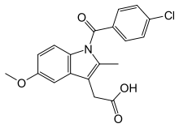
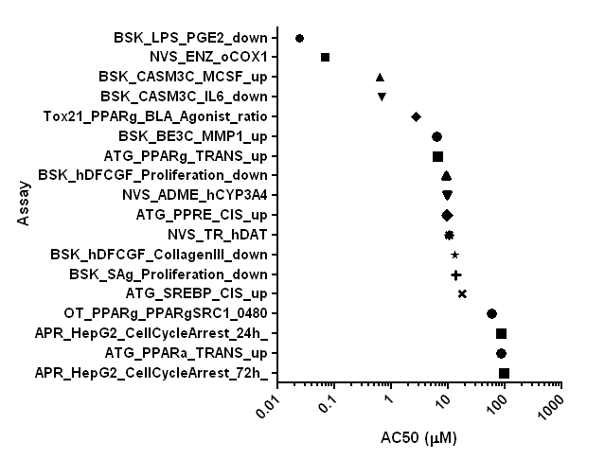

Where does this immense amount of mechanistic data get us?
So What?
Can we expect this perturbation lead to an adverse outcome?

Slide 11

Information Overload!!

Slide 12



Wide range of diagnostic tests are employed in medicine
Doctors explain to patients, what the results of those tests mean relative to health.

Slide 13

To effectively apply this potential wealth of data – need to dramatically scale up our ability to interpret those data and use in decision-making.
Regulatory relevance
  Human health
  Ecological fitness
Adverse Outcome Pathway Framework

Slide 14
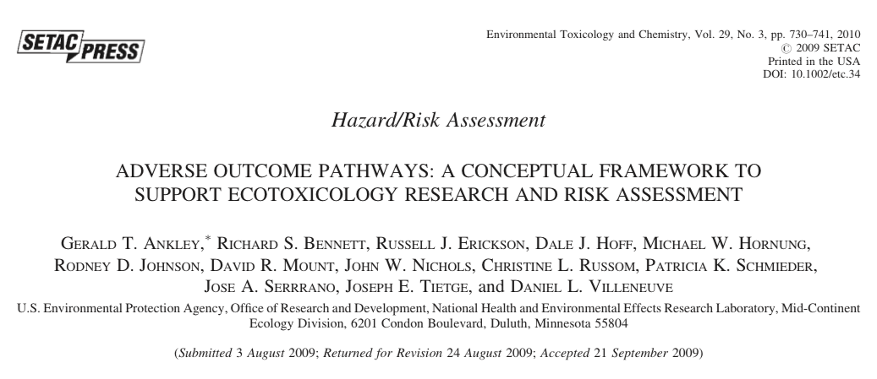
“Ankley et al., 2010”
Ankley et al., Environmental Toxicology and Chemistry, 29(3), 2010, 730-741

Slide 15
Definition
  An Adverse Outcome Pathway is a conceptual construct that portrays existing knowledge concerning the linkage between a direct molecular initiating event and an adverse outcome at a biological level of organization
      relevant to risk assessment
      relevant to human or ecosystem health
      of interest
  AOPs are a sequential series of events that, by definition, span multiple levels of biological organization
Ankley et al., Environmental Toxicology and Chemistry, 29(3), 2010, 730-741

Slide 16
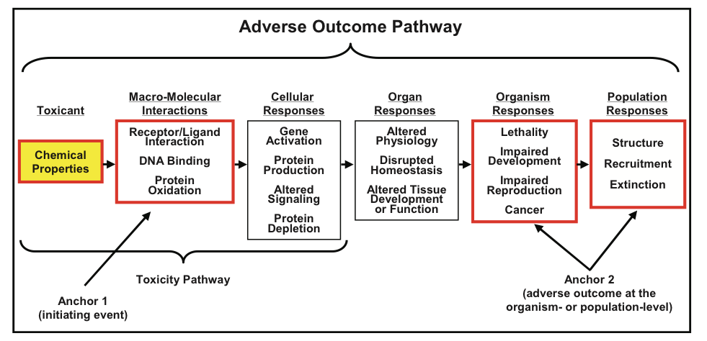
Representation
Ankley et al., Environmental Toxicology and Chemistry, 29(3), 2010, 730-741

Slide 17

Conceptually AOPs are not new

Slide 18
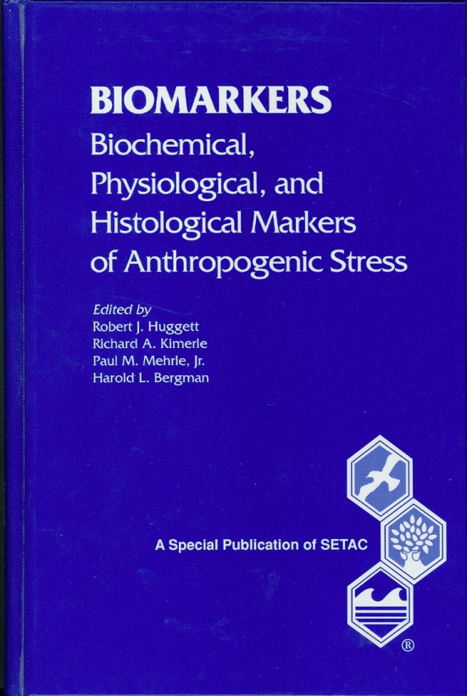

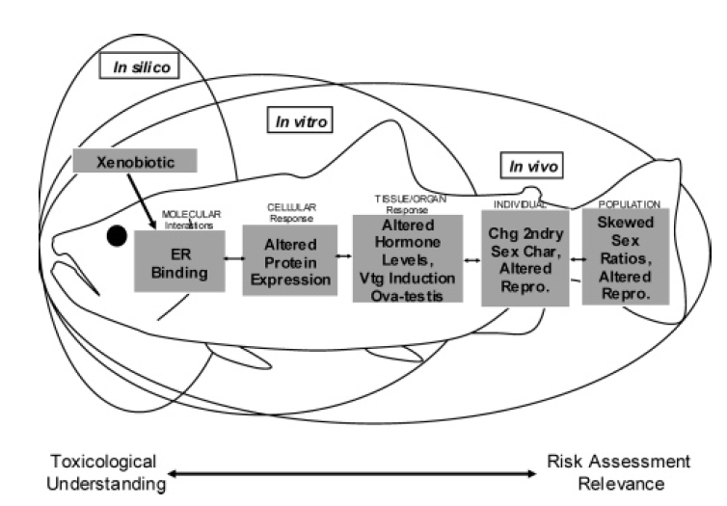
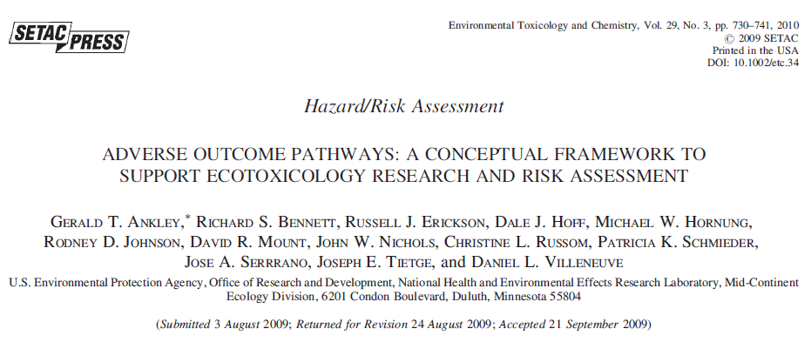
AOP Concept in Ecotoxicology
1992
SETAC Pellston workshop on biomarkers – identified need for linkages across levels of organization to support use of biomarkers in ERA.
Mid 90s
Schmieder, Bradbury, Veith, others in ecotox community – concept to support application of QSARs and biomarkers in ERA.
Bradbury et al. (ES&T Dec. 1, 2004) – publication of the concept as a means to support greater use of in silico and in vitro approaches in risk assessment – termed “Toxicity Pathway”
2004
2004
Schmieder et al. (ES&T 38:6333-6342) – published a “toxicity pathway” linking ER binding to potential population-level consequences.
2007
NRC report on Toxicity Testing in the 21st Century – advocated paradigm similar to Bradbury et al – defined “toxicity pathway” as “cellular response pathways that, when sufficiently perturbed, are expected to result in adverse health effects”
2009, 2010
Use of AOP term at McKim conferences – introduction of AOP terminology into OECD QSAR tool-box discussions
MED working group published definition of “Adverse Outcome Pathways”, describe application in Ecotox and Ecological Risk Assessment. ET&C 2010.
2010

Slide 19
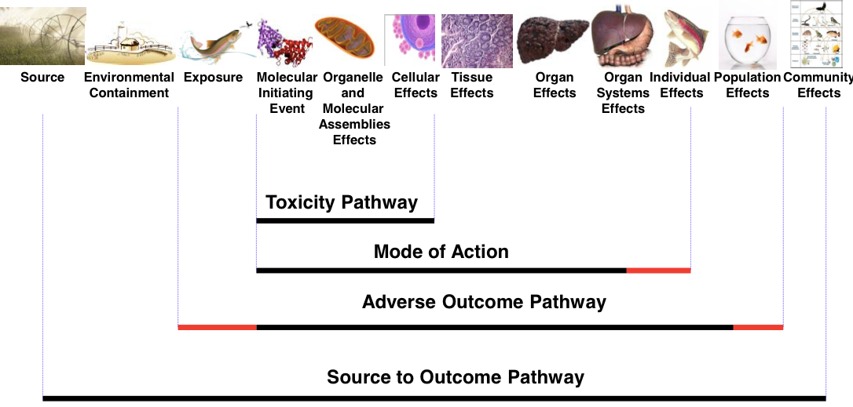
Pathway-based approaches

Slide 20
AOP and MOA
AOP says: This is a biological perturbation that can lead to a specific adverse outcome, and here is how we think that it happens.
MOA analysis says: Available data indicate that this AOP is relevant to a specific chemical of interest.
KEs in the AOP are measurement endpoints that are used to verify that a given chemical operates via a defined AOP.
The body of MOA analyses demonstrating the relevance of selected AOPs for specific chemicals contributes increased confidence in the application of AOP to other chemicals that trigger similar perturbations, in the absence of a full set of downstream KE measurements.

Slide 21

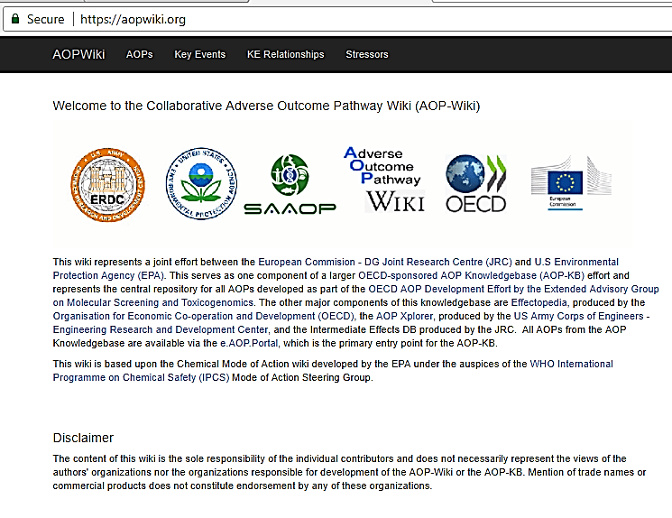
Precise and Harmonized Terminology
&
Availability of Scientific
Tools
MIE Molecular Initiating Event
KE Key Event
KER Key Event Relationship
AO Adverse Outcome
MIE and AO are “special case” KEs
Aopwiki.org

Slide 22

Building Blocks of AOPs
KE
A measurable change in biological state that is essential to the progression of an adverse outcome.
MIE
Point of chemical/stressor interaction at the molecular level
(specialized KE)
AO
Adverse effect of regulatory significance
(specialized KE)
KER
Contains evidence for causal relationship between the upstream KE and downstream KE
Notes:
KE
How is it Measured?
Level of Biological Organization (molecular, cellular, tissue, organ, individual, population)
Taxonomic Applicability
Life Stage Applicability
Sex Applicability
MIE
All same criteria as any other KE (taxa, life stage, sex, etc…)
Plus TWO additional Criteria
Evidence for Perturbation of MIE by Chemical/Stressor
List of Known Chemicals/Stressors
AO
(ex: an established protection goal or equivalence to endpoint in an accepted regulatory guideline toxicity test)
All same criteria as any other KE (taxa, life stage, sex, etc…)
Plus ONE additional Criteria
Regulatory Significance of the AO (with examples of reg. usage)
KER
Facilitates inference/extrapolation/prediction of KEdown based on the state of KEup

Slide 23
Key Events
KE1
KE2
KE3
Etc…
A measurable change in biological state that is essential to the progression of an adverse outcome.
  How is it Measured?
  Level of Biological Organization (molecular, cellular, tissue, organ, individual, population)
  Taxonomic Applicability
  Life Stage Applicability
  Sex Applicability

Slide 24
Molecular Initiating Event (MIE)
MIE
KE1
KE2
Etc…
A specialized Key Event
Point of chemical/stressor interaction at the molecular level
  All same criteria as any other KE (taxa, life stage, sex, etc…)
  Plus TWO additional Criteria
    Evidence for Perturbation of MIE by Chemical/Stressor
    List of Known Chemicals/Stressors

Slide 25
Adverse Outcome (AO)
KE3
KE4
AO
A specialized Key Event
Adverse effect of regulatory significance
(ex: an established protection goal or equivalence to endpoint in an accepted regulatory guideline toxicity test)
  All same criteria as any other KE (taxa, life stage, sex, etc…)
  Plus ONE additional Criteria
    Regulatory Significance of the AO (with examples of regulatory usage)

Slide 26
Key Event Relationship (KER)
MIE
KE1
KE2
KE3
AO
Contains evidence for causal relationship between the upstream KE (KEup) and downstream KE (KEdown)
Facilitates inference/extrapolation/prediction of KEdown based on the state of KEup

Slide 27
Key Event Relationship (KER)
MIE
KE1
KE2
KE3
AO
KER Description
Level of Biological Organization
Taxonomic Applicability
Life Stage Applicability
Sex Applicability
EVIDENCE SUPPORTING KER
  Biological Plausibility
  Empirical Evidence
  Quantitative Understanding
  Uncertainties and Inconsistencies

Slide 28
KER Evidence: Biological Plausibility
Rationale for a connection between KE_{up} and KE_{down}
Typically based largely on understanding of “normal” unperturbed biology
Example:
  Normal Biology: Eggshells are made of CaCO3 (Calcium Carbonate) from eggshell gland
  ∴ Reduced CaCO3 in gland will produce less calciferous shells

Slide 29
References
Example Support for KERs: Biological Plausibility
Aromatase is rate-limiting for 17β-estradiol synthesis
Cholesterol
Aromatase
Inhibition
Granulosa
Reduced E2 synthesis
CYP11A
CYP17 (hydroxylase)
CYP17 (lyase)
Pregnenolone
17a-OH-Pregnenolone
DHEA
If A, then B
3b-HSD
3b-HSD
3b-HSD
CYP17 (hydroxylase)
CYP17 (lyase)
Progesterone
17a-OH-Progesterone
Androstenedione
CYP19
estrone
CYP21
CYP21
20b-HSD
17b-HSD
17b-HSD
CYP19
11-deoxycorticosterone
Testosterone
17b-estradiol
CYP11B1
11-deoxycortisol
17α20β-dihydroxy-4-pregnen-3-one
CYP11B1
corticosterone
11β-OH-Testosterone
CYP11B2
CYP11B2
11βHSD
aldosterone
cortisol
11-Ketotestosterone

Slide 30
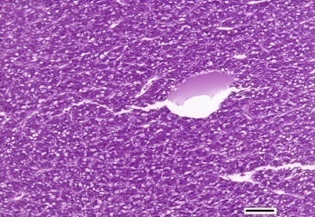
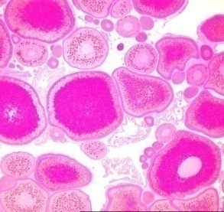
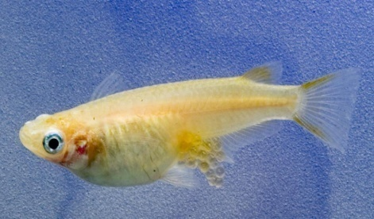
Example Support for KERs: Biological Plausibility
References
Estrogen
Receptor
Hepatocyte
Ovary
Female
Population
Agonism
Vtg
production
Oocyte
development
Ovulation
& spawning
Stable or
increasing
trajectory
ERE-Vtg
Known | Inferred
17β-estradiol (E2) regulates vitellogenin (Vtg) synthesis | Decreased will cause decreased Vtg synthesis
Vtg is a critical egg yolk precursor that accounts for 95% of egg mass/volume | Lack of Vtg will impair oocyte development
Eggs must be released from the ovarian follicles into the environment to be fertilized | Failure to ovulate and spawn will prevent reproduction
Reproduction is required for population sustainability | Reduced reproductive success may lead to population failure

Slide 31
KER Evidence: Empirical Evidence
Specific studies that demonstrate when KE_{up} is impacted, KE_{down} is also affected
Can establish association between KE_{up} and KE_{down} even if a biologically plausible relationship is not understood
Based on the Bradford Hill Criteria for Causality
  Originally developed for evaluating causal relationships in epidemiological studies
  A set of criteria for evaluating the statement: “A causes B”

Slide 32
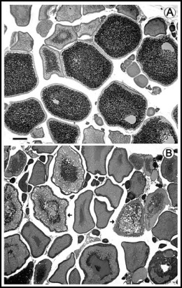
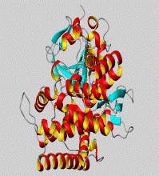
Example Support for KERs: Empirical Evidence
References
Aromatase
Inhibition
Granulosa
Reduced E2 synthesis
Plasma
Reduced circulating E2
Hepatocyte
Reduced VTG production
Ovary
Impaired Oocyte Dev.
Female
Decreased ovulation/spawn
Population
Declining Trajectory
Impaired vitellogenesis
Reduced fecundity
Reduced E2, Vtg synthesis
Is there evidence?
Aromatase inhibition
Not only is it biologically plausible – its supported by empirical evidence
Consistent profile of effects have been observed with other cyp19 inhibitors and in other species :
Prochloraz, fathead minnow: Toxicol. Sci. 2005. 86: 300-308
Propiconazole, fathead minnow: Toxicol. Sci. 2013. 132: 284-297.
Letrozole, Japanese medaka: Compar. Biochem. Physiol. Pt. C, 2007, 145: 533-541

Slide 33
Empirical Evidence: Dose-response Concordance
  Does KE_{up} occur at lower doses for tested stressors than KE_{down}?
No
Yes!
KE₂
KE₁
KE₂
KE₁
Magnitude of response
Magnitude of response
Concentration/dose
Concentration/dose
ESTABLISHES SUPPORT FOR CAUSALITY

Slide 34
Empirical Evidence: Temporal concordance
  Does KE_{up} occur before you see effects on KE_{down}?
KE₁
No
KE₂
Yes!
KE₁
KE₂
Magnitude of response
Magnitude of response
Time
Time
ESTABLISHES SUPPORT FOR CAUSALITY

Slide 35
Example Support for KERs
Temporal concordance
Aromatase
Inhibition
Granulosa
Reduced E2 synthesis
Plasma
Reduced circulating E2
Hepatocyte
Reduced VTG production
Ovary
Impaired Oocyte Dev.
Female
Decreased ovulation/spawn
Population
Declining Trajectory
<6h
12 h
24 h
days
weeks
years
4
3
2
**
**
1
8
0
6
6 Hour
12 Hour
24 Hour
4
50
(c)
KE1
2
**
*
40
0
12 Hour
24 Hour
30
*
6 Hour
20
KE2
10
0
6 Hour
12 Hour
24 Hour
KE3

Slide 36
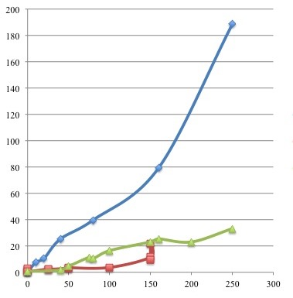
Empirical Evidence: Incidence concordance
  Does KE_{up} occur as or more frequently than KE_{down}?
KE1
Number of individuals in population for which effect is observed
KE2
KE3
Dose of Administered Stressor
ESTABLISHES SUPPORT FOR CAUSALITY

Slide 37
Weight of Evidence (WoE) Evaluation
Support for Biological Plausibility of KERs | High | Moderate | Low
 | Extensive understanding based on extensive previous documentation and broad acceptance -Established mechanistic basis. | The KER is plausible based on analogy to accepted biological relationships but scientific understanding is not completely established. | There is empirical support for a statistical association between KEs, but the structural or functional relationship between them is not understood.
Empirical Support for KERs | High | Moderate | Low
 | Multiple studies showing dependent change in both events following exposure to a wide range of specific stressors. | Demonstrated dependent change in both events following exposure to a small number of specific stressors and some evidence consistent with expected pattern that can be explained | Limited or no studies reporting dependent change in both events following exposure to a specific stressor and/or significant inconsistencies in empirical support across taxa and species
Extent of Quantitative Understanding | High | Moderate | Low
 | Change in KEdown can be precisely predicted based on a relevant measure of KEup. Uncertainty in the quantitative prediction can be precisely estimated from the variability in the relevant measure of KEup. | Change in Kedown can be precisely predicted based on a relevant measure of KEup. Uncertainty in the quantitative prediction is influenced by factors other than the variability in the relevant measure of KEup. | Only a qualitative or semi-quantitative prediction of the change in KEdown can be determined from a measure of KEup.

Slide 38
Support for Essentiality
Support for essentiality is another important line of evidence assembled as part of an AOP description.
Ovary
Impaired Oocyte Dev.
Female
Decreased ovulation/spawn
Population
Declining Trajectory
Evaluated with respect to whether blocking /preventing a given KE prevents the downstream KEs from occurring.
Hepatocyte
Reduced VTG production
Ovary
Impaired Oocyte Dev.
Female
Decreased ovulation/spawn
Population
Declining Trajectory
Plasma
Reduced circulating E2
Hepatocyte
Reduced VTG production
Ovary
Impaired Oocyte Dev.
Female
Decreased ovulation/spawn
Population
Declining Trajectory
Granulosa
Reduced E2 synthesis
Plasma
Reduced circulating E2
Hepatocyte
Reduced VTG production
Ovary
Impaired Oocyte Dev.
Female
Decreased ovulation/spawn
Population
Declining Trajectory
Aromatase
Inhibition
Granulosa
Reduced E2 synthesis
Plasma
Reduced circulating E2
Hepatocyte
Reduced VTG production
Ovary
Impaired Oocyte Dev.
Female
Decreased ovulation/spawn
Population
Declining Trajectory

Slide 39
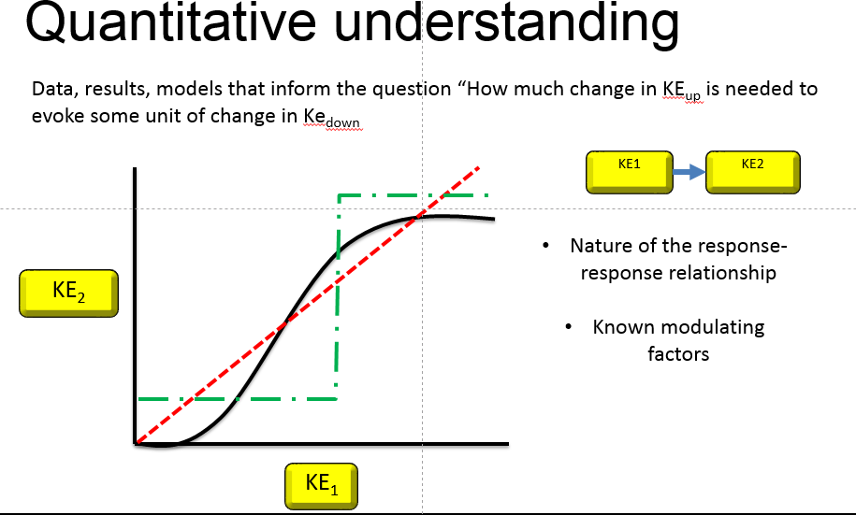
Support for KERs

Slide 40
KER Adjacency
Adjacent KERs:
  Evidence linking KEs immediately up/down-stream in AOP sequence
Non-adjacent KERs:
  Placeholders for evidence between KEs that are often measured together, but not in sequence
  Not necessarily an alternate “path/mechanism”
Non-adjacent KER
MIE
KE1
KE2
KE3
AO
Adjacent KERs

Slide 41
KER: The AOP work horse!
  Biological Organization
  Modulating Factors
  Incidence Concordance
  KER
  Description
  Taxonomic Applicability
  Temporal Concordance
  Feedback Loops
  Sex Applicability
  Life Stage
  Dose Concordance
  Biological
  Plausibility
  WoE
  Quantitative Understanding

Slide 42
So how to AOPs help with understanding what these data mean?
So What?
Can we expect this perturbation lead to an adverse outcome?

Slide 43
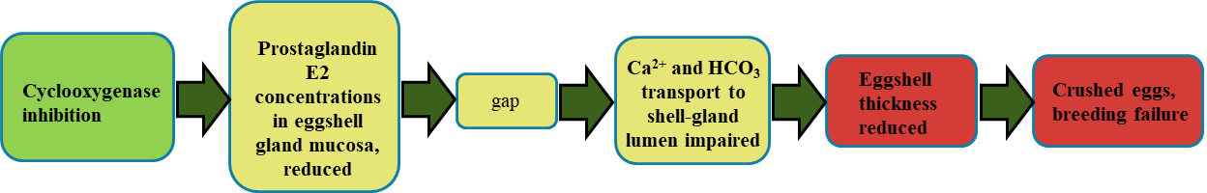
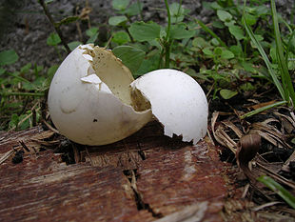
Ah-ha
Breeding failure relevant to Risk Assessors

Slide 44
Introduction
A set of chemicals for which there may be reason expect egg-shell thinning

Slide 45
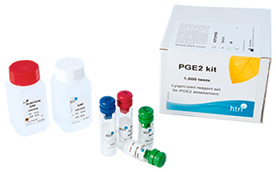
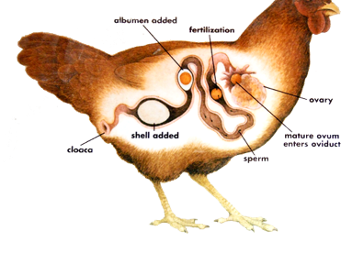
Alternative tests: Suggests informative endpoints we may be able to measure more rapidly and cost-effectively in laboratory toxicity tests.
Biomarkers: Suggests biomarkers we could measure in animals from the environment – early warning; diagnostic
Particularly if we can translate into a quantitative prediction of probability or severity of AO.
Diagnostic potential: Suggests an etiology for observed patterns of biological response – may help trace back to causative agents and/or sources.

Slide 46
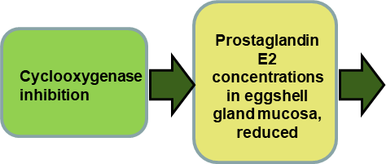
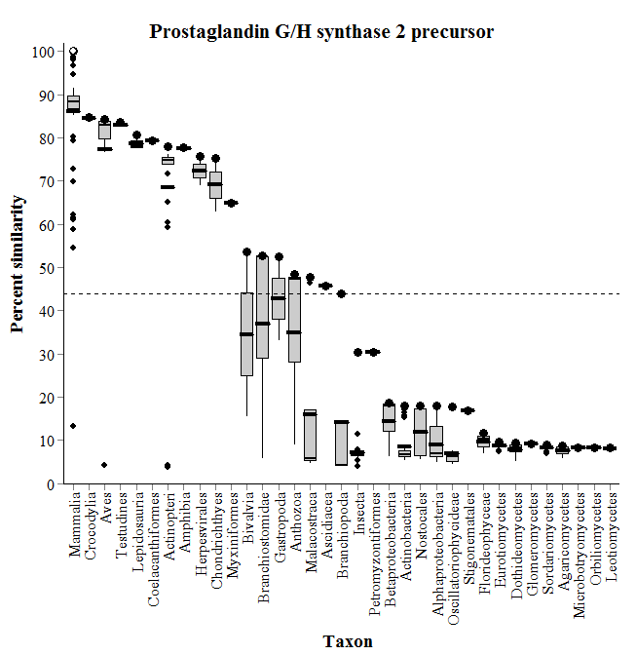



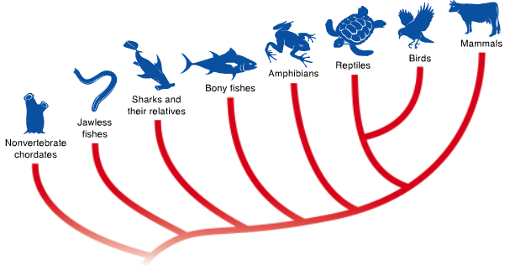




Introduction
Introduction
Taxonomic Relevance: What species does this AOP apply to?
For which endpoints/key events can data from “model organisms” reasonably be applied
SeqAPASS

Slide 47

What AOPs can do for us:
Enhance use of mechanistic data in regulatory decision-making
Support hypothesis-driven testing - target in vivo testing on endpoints of concern
Inform appropriate cross-species extrapolation & focus testing on species, life-stages, taxa of concern
Aid a strategic, knowledge-driven approach to evaluating complex mixtures
Identify critical knowledge & evidence gaps that impede application

Slide 48

What AOPs are not:
AOPs are not risk assessments
  Do not explicitly address exposure
AOPs are not synonymous with HTT or pathway-based assays
  Aid interpretation of HTT and pathway-based assay data in the context of apical hazard
AOPs are not Computational Models
  Computational models that align with AOPs and can be used to simulate KERs along the AOP and predict state of KEs under various conditions/scenarios termed qAOPs.
AOPs are not a panacea
  Don’t solve challenges of in vitro / in vivo extrapolation
  Don’t account for all known biology or all possible modulating variables

Slide 49
Introduction to AOPs Part II
Principles and Best Practices in AOP Development

Slide 50


Principles of AOP Development
Increasing level of biological organization
stressor
Molecular initiating
event (MIE)
Adverse outcome (AO)

Slide 51
How should AOPs be developed?

Slide 52
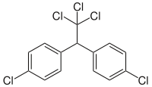
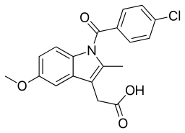
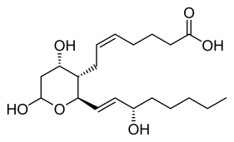
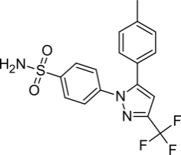
1. AOPs are not chemical-specific
Not trying to describe what a single chemical does
Trying to describe what ANY chemical that perturbs the MIE with sufficient potency and duration is likely to do
?
?
?

Slide 53

2. AOPs are modular
The two primary building blocks:
1) Key Events
2) Key Event Relationships
ARE SHAREABLE!!
KE2
AO
KE1
KE2
MIE
KE1
KE3
MIE2
KE4
AO2
KEs and KERs are not unique to a single AOP
Do not need to be regenerated independently for every new AOP

Slide 54
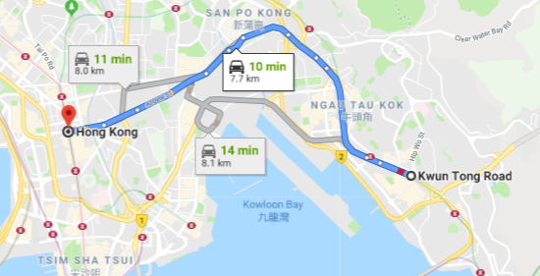
3. AOPs are a pragmatic functional unit of development and evaluation
By convention, an AOP consists of a single linear sequence of key events connecting an MIE to AO
(i.e. no branches! …. some exceptions)
An AOP is a pragmatic simplification of complex biology
Not intended to represent every way…
but a single set of directions

Slide 55
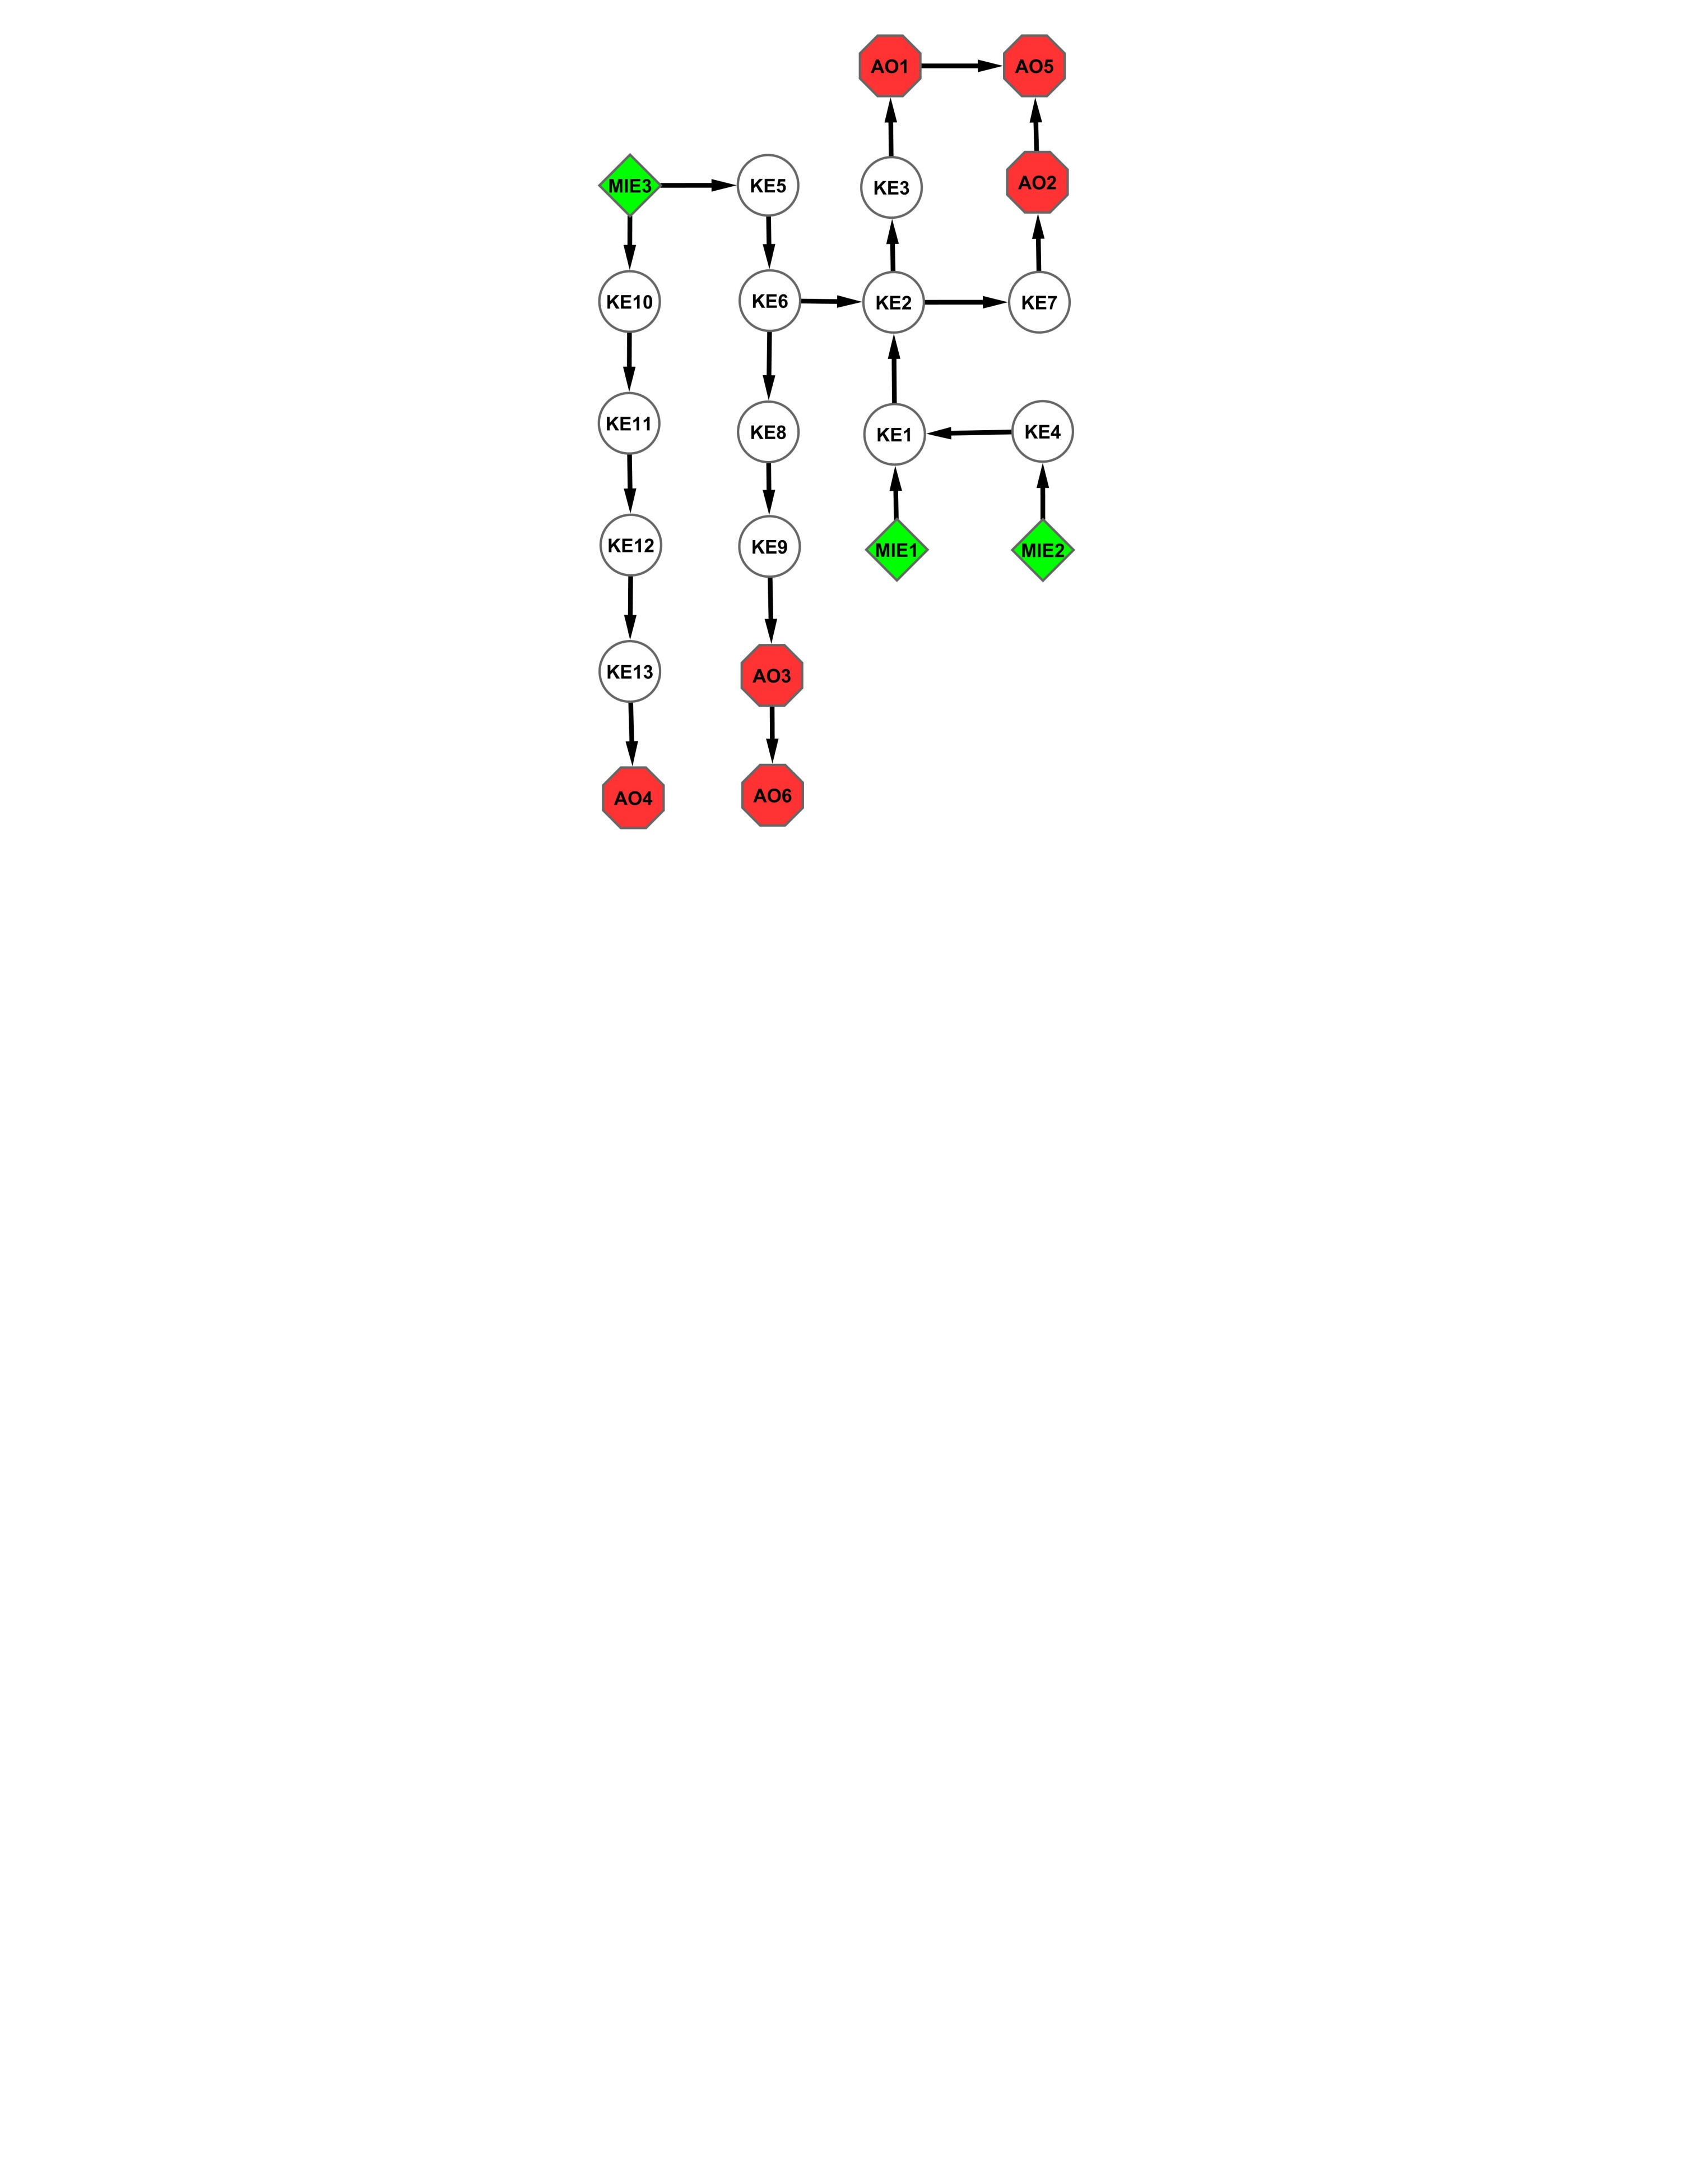
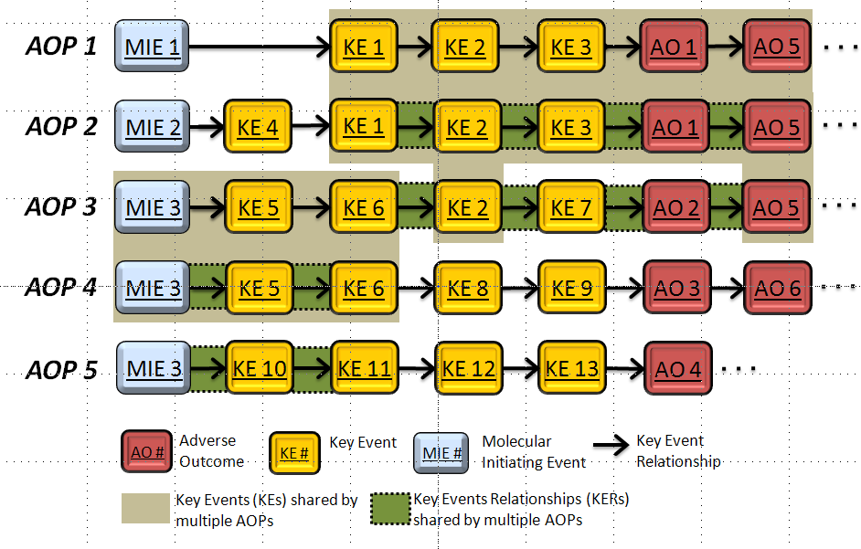
4. For most real-world applications, AOP networks are the functional unit of prediction
AOP networks (i.e. sharing of modular components) aim to describe the complexity of potential interactions

Slide 56

5. AOPs are living documents
AOPs are a way of organizing existing knowledge
As methods for observing biology evolve:
  New possibilities for KEs
  Ability to measure KEs with greater precision/accuracy
As new experiments are published:
  Weight of evidence supporting (or rejecting) KERs grows
  New AOPs and new branches in AOP networks discovered
There is no objective definition of a “complete” AOP

Slide 57
Principles of AOP Development
5. AOPs are living documents
Operationally-defined “stages” of AOP development
Stages of AOP Development | Characteristics
Putative AOPs: | Hypothesized set of KEs and KERs primarily supported by biological plausibility and/or statistical inference
Formal AOPs: | Include assembly and evaluation of the supporting weight of evidence – developed in AOP knowledgebase in accordance with internationally-harmonized OECD guidance
Quantitative AOPs: | Supported by quantitative relationships and/or computational models that allow quantitative translation of key event measurements into predicted probability or severity of adverse outcome
Increasing
Depth of evidence /understanding
Transparency /defensibility
Quantitative precision
Cost
Data needs
Time
All stages have potential utility
Level of development desired/required depends on the application

Slide 58
Properties of AOPs
  AOPs are living documents
  I am developing an AOP. When will it be ready?
  Never
  When it is fit for purpose
  Analytical methods evolve
  New experiments are published

Slide 59
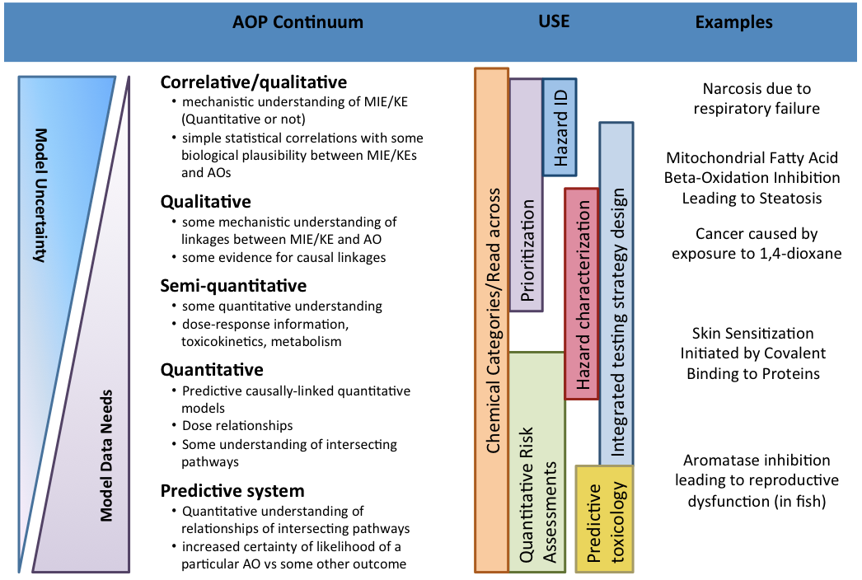
Perkins et al., Toxicological Sciences, 148(1), 2015, 14–25

Slide 60
Mapping out an AOP
FAQ:
Q: What is the minimum number of elements that can constitute an AOP?
A: Three. A minimum of one AO and one upstream KE, linked by a KER.
Q: How many KEs should I include in my AOP?
A: There is no one-size fits all/universal answer.
Convention:
Aspirationally, one KE at each level of biological organization
One MIE
At least one AO of demographic significance (AOP can have more than one AO)
Molecular
Cellular
Tissue
Organ
Organ System
Individual
Population

Slide 61
MIEs
Typically one per AOP
Can link to any number of separate AOPs
Exception:
  Two events MUST occur to trigger the downstream KE.
KE1 and KE2 must occur for KE3 to occur
Not
KE1 or KE2 must occur for KE3 to occur
.

Slide 62
AO
Can have more than one per AOP if they represent a single progression of injury
In possible try to extend to an AO of demographic significance.
steatohepatitis
Fibrosis
Cirrhosis
Hepatocellular Carcinoma
Steatosis
…
LXR Activation
…
A.
Multiple AOs in a single, sequential progression = single AOP
Liver failure
steatohepatitis
Fibrosis
Cirrhosis
Hepatocellular Carcinoma
Steatosis
…
LXR Activation
…
B.

Slide 63
Mapping out an AOP
Q: What is the maximum number of KEs that can be included in an AOP?
A: In theory, there is no maximum number of KEs.
However: key principle
Individual AOPs are a pragmatic simplification
It is not necessary to capture everything you know about the biology as KEs in the AOP.
Focus on KEs that could be measured in a relatively routine manner – evidence to support KERs more likely to be available
Focus on establishing plausibility and verifiability

Slide 64
Mapping out an AOP
Think in terms of AOP networks
It is not necessary to capture everything you know about the biology as KEs in a single AOP.
AOPs are modular
Individual AOPs are a pragmatic simplification
AOP networks are the functional unit of prediction (in most cases)

Slide 65
Mapping out an AOP
If building multiple AOPs can map out a network and plan out which KEs and KERs will be shared so they can be properly linked in the AOP-Wiki.
Can harmonize naming and make sure KEs/KERs are created in a way that works for multiple AOPs.
Avoids creating unneeded KEs (junk content) in the AOP-Wiki.
Avoids making-and breaking KERs (which can cause confusion).

Slide 66
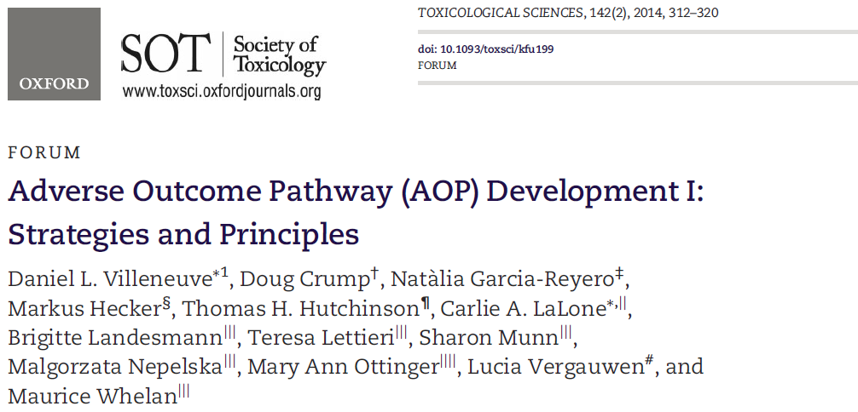
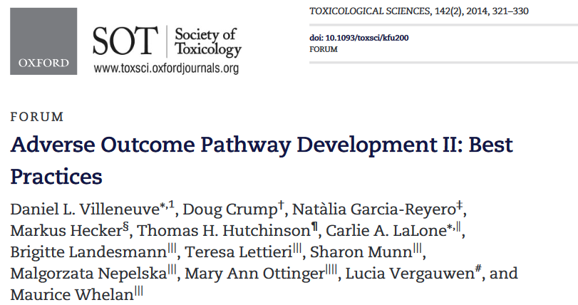
Authors:
D. Villeneuve
D. Crump
N. Garcia-Reyero
M. Hecker
T. Hutchinson
B. Landesmann
T. Lettieri
S. Munn
M. Nepelska
M. Ottinger
L. Vergauwen
M. Whelan

Slide 67
The Human AOP
Interactive exercise in AOP Development

Slide 68
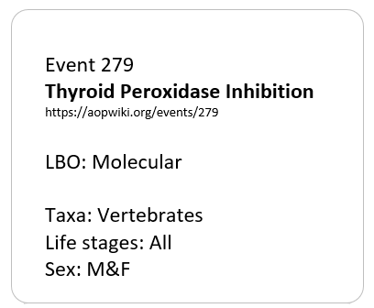
Event Card Information
Event ID: Number assigned in the AOP-Wiki
Event Title:
Level of Biological Organization (LBO):
Taxonomic applicability (Taxa):
Life stages applicability:
Sex applicability: Male/Female/M&F

Slide 69
AOP 175
Thyroid Hormone synthesis, Decreased
Thyroxine (T4) in serum, Decreased
Thyroxine (T4) in tissues, decreased
Triiodothyronine (T3) in tissues, decreased
Metamorphosis altered
Thyroperoxidase, Inhibition
AOP 42
Thyroperoxidase, Inhibition
Thyroid Hormone synthesis, Decreased
Thyroxine (T4) in serum, Decreased
Thyroxine (T4) in neuronal tissues, Decreased
Hippocampal gene expression, Altered
Hippocampal anatomy, Altered
Hippocampal Physiology, Altered
Cognitive function, decreased
AOP 159
Thyroperoxidase, Inhibition
Thyroid Hormone synthesis, Decreased
Thyroxine (T4) in serum, Decreased
Anterior swim bladder inflation, reduced
Hearing, reduced
Young of year survival, reduced
Population trajectory, decreased
AOP 159
Thyroperoxidase, Inhibition
Thyroid Hormone synthesis, Decreased
Thyroxine (T4) in serum, Decreased
Anterior swim bladder inflation, reduced
Swimming performance, reduced
Young of year survival, reduced
Population trajectory, decreased
AOP 30
Vitellogenin synthesis in liver, Reduction
Plasma vitellogenin concentrations, Reduction
Vitellogenin accumulation into oocytes and oocyte growth/development, Reduction
Cumulative fecundity and spawning, Reduction
Estrogen receptor (ER), Antagonism
Population trajectory, Decrease
AOP 21
Aryl hydrocarbon receptor (AhR), Activation
AhR/ARNT,
Dimerization
Cyclooxygenase 2 (COX-2) expression, Increase
Cardiovascular development/function, Altered
Early life stage mortality, Increase
AOP 150
Aryl hydrocarbon receptor (AhR), Activation
AhR/ARNT,
Dimerization
ARNT/HIF1-alpha, dimerization reduced
VEGF production, reduced
Endothelial network, impairment
Cardiovascular development/function, Altered
Early life stage mortality, Increase
Notes:
29 Unique KEs

Slide 70
Cyclooxygenase 2 (COX-2) expression, Increase
Aryl hydrocarbon receptor (AhR), Activation
AhR/ARNT,
Dimerization
Cardiovascular development/function, Altered
Early life stage mortality, Increase
ARNT/HIF1-alpha, dimerization reduced
VEGF production, reduced
Endothelial network, impairment
Thyroxine (T4) in tissues, decreased
Triiodothyronine (T3) in tissues, decreased
Metamorphic development, altered
TPO inhibition
TH synthesis, decreased
TH in serum, decreased
TH in neuronal tissues, decreased
Hippocampal gene expression, altered
Hippocampal anatomy, altered
Hippocampal function, decreased
Cognitive function, decreased
Hearing, reduced
Anterior swim bladder inflation, reduced
Young of year survival, reduced
Population trajectory, decreased
Swimming performance, reduced
Vtg synthesis in liver, Reduction
Vitellogenin accumulation into oocytes and oocyte growth/development, Reduction
Cumulative fecundity and spawning, Reduction
ER antagonism
Plasma Vtg conc.,
Reduction
Notes:
Network version – will update with the rest of the AOPs; we could show this slide after the participants have self-organized.

Slide 71
AOPs in practice: Part I
A Tool to Crowd-Source Development and Application: Introduction to the AOP-Wiki

Slide 72
Formalization
Principles of AOP development
Weight of evidence evaluation
Regulatory acceptance of AOPs

Slide 73



The AOP-KB
https://aopwiki.org/
https://www.effectopedia.org
https://aopkb.oecd.org/
Notes:
There is one central AOP-KB
There are different ways to interface with the AOP-KB
-Currently two main tools for developing AOP content are AOP-Wiki and Effectopedia
AOP-Wiki is very text-based; structured machine-readable text (controlled vocabularies); free-text
Effectopedia – visual development style - graphically oriented interface
-Content can be retrieved / consumed from either AOP-Wiki or Effectopedia
AOP-Wiki – text-based pages; readable and printable as snap-shots
eAOP Portal – a Google-like search page for finding AOPs
Links from 3rd party tools – e.g., US EPA chemistry dashboard
Looking for feedback on how to make the experience even better for content developers and providers

Slide 74
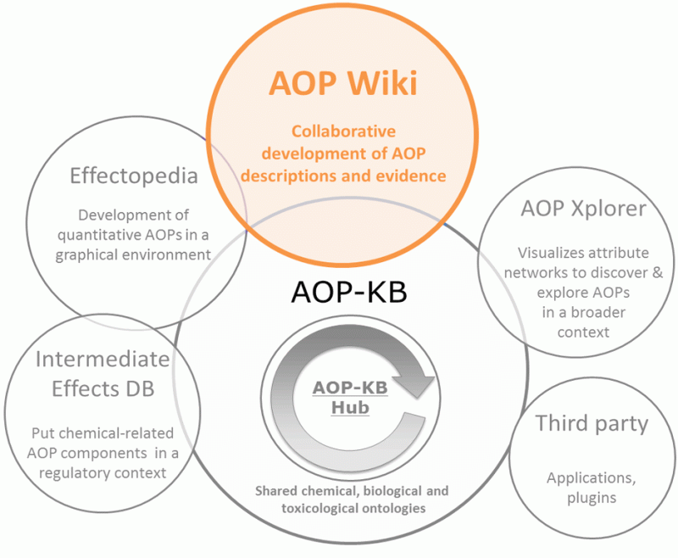

AOP-knowledgebase
http://aopwiki.org
http://aopkb.org

Slide 75


Introduction to the AOP-Wiki
Global AOP Network (as of April 2018)
  220 User-defined AOPs
  471 user-specified linear AOPs
  840 KEs
  1050 KERs

Slide 76


Content of an AOP Description
Aopwiki.org
KE Pages
KE Pages
Description
Measurement/ detection
Domain of applicability
AOP Page
KER Pages
Title
Description
Biological plausibility
Empirical support
Inconsistencies and uncertainties
Quantitative understanding

Slide 77


Accessing the AOP-Wiki
https://aopwiki.org/#Requesting Access to Create and Edit AOPs
Read access
Open to anyone, no account required
Commenting
Create account, no approvals required
Development/write access
Create account
Submit brief developer application for approval
http://www.saaop.org/AccessPage.html.

Slide 78


Accessing the AOP-Wiki

Slide 79

Aopwiki.org

Slide 80

Search AOPs
Search by
Author
Key words
Status

Slide 81



Properties of AOPs
  Naming convention
MIE
leading to
AO
Villeneuve et al., Toxicological Sciences, 142(2), 2014, 312–320
Villeneuve et al., Toxicological Sciences, 142(2), 2014, 321–330

Slide 82

AOP Page Overview
Structured fields
  Summary of AOP
  Applicability
Overall Assessment
  Applicability
  WoE
  Potential appl.

Slide 83

EVENT Page Overview
Structured fields
  Ontologies
  Stressors
  Applicability
Free text
  Description
  Methods for measuring
  Applicability

Slide 84

Relationship Page Overview
Structured fields
  Applicability
Free text
  Description
  WoE
    Plausibility
    Empirical
    Un / In
  Quantitative understanding
  Applicability

Slide 85

Stressor pages
AOPs are chemical agnostic
There is interest in linking AOPs to relevant chemical categories/domains

Slide 86



AOP Networks

Slide 87

AOP Description
References
Modular organization.
Allows independent KE, KER pages to be linked to multiple AOPs.
https://aopwiki.org/
Page contents align with sections of the “User’s Handbook”

Slide 88


Getting Oriented
Get an overview of what the AOP is about
Found on the AOP page in the AOP-Wiki; first page or two of pdf snap shot

Slide 89





Getting Oriented
Grab a road map
Aromatase
Inhibition
Granulosa
Reduced E2 synthesis
Plasma
Reduced circulating E2
Hepatocyte
Reduced VTG production
Ovary
Impaired Oocyte Dev.
Female
Decreased ovulation/spawn
Population
Declining Trajectory
Easiest to find on the AOP-Wiki page; often buried or absent from the pdf snap shot

Slide 90

Getting Oriented
Snap shots will be laid out basically as shown:
Title, abstract, background
KE content pages
KER content pages
Overall assessment of the AOP
  Domain of applicability and rationale
  Support for essentiality
  Weight of evidence summary

Slide 91





Getting Oriented - Event Pages
Four most important sections
Is it clear what biology the KE refers to?
What is the “sign post”
Click on Event Links from AOP page to navigate to corresponding KE page

Slide 92

Getting Oriented - Event Pages
Should refer to an observable/measurable change, how to measure or observe it, and in what taxa, life-stage, and sex it can be observed
By intent, the contents should be stand-alone without reference to other KEs in the AOP
Event pages do not provide evidence that measureable entity is impacted by a specific stressor or other biological change – except in the case of the MIE

Slide 93
Getting Oriented – Relationship Pages
Each KER represents a predictive relationship between a pair of key events that can be supported by weight of evidence.
Relationship is causal – one KE causes the other
Much of the content pertaining to scientific quality will be found on the individual relationship pages.
By intent, they include only support that references that specific pair of KEs – generally will not reference other KEs in the pathway

Slide 94











Getting Oriented – Relationship Pages
Click Links in the Relationship Table found on the AOP page

Slide 95
Getting Oriented – Relationship Pages
Should describe the conditions/biological context in which this KER operates
  A specific tissue context
  Duration of impact at KEup
May also detail biology that is operable but not represented at KEs in the pathway

Slide 96
Support for KERs
Define the biological rationale for a connection between KE_{upstream} and KE_{downstream}
What are the structural or functional relationships between the KEs?

Slide 97
Support for KERs
Evidence that supports the idea that a change in the upstream KE (KE_{upstream}) will lead to, or is associated with, a subsequent change in the downstream KE (KE_{downstream}), assuming the perturbation of KE_{upstream} is sufficient.
Helpful to provide as much detail about the toxicological and biological context in which the measurements were made, as is feasible, including the stressor(s) tested, the effective doses at each KE, etc.

Slide 98

OECD AOP development program

Slide 99
Submission and review process
Contact national coordinator of the Test Guidelines Prg.
Submit project proposal to OECD
Added to AOP work plan by EAGMST
(Jun, Dec)
External review, nominated by WNT
(Sept-Dec)
Internal review
by EAGMST
(Feb-Apr)
Develop AOP in AOP-Wiki
Endorsement by WNT and TFHA
Publication in OECD series on AOPs
EAGMST: Extended Advisory Group on Molecular Screening and Toxicogenomics
WNT: Working Group of the National Coordinators of the Test Guidelines Programme
TFHA: Task Force on Hazard Assessment

Slide 100

AOP-Wiki: navigation

Slide 101

Resources
  Guidance document on developing and assessing AOPs

Slide 102
AOP-Wiki
https://aopwiki.org/

Slide 103
AOPs in practice: Part II
Principles to Practice: Hands-on Exploration of the AOP-Wiki

Slide 104
Training AOP-Wiki
https://training.aopwiki.org/

Slide 105

Take home
Glass half empty | Glass half full
Do not have AOPs defined for all relevant pathways | AOP-KB is expanding steadily; crowd-sourced activity
AOPs do not account for exposure, toxicokinetics, and ADME | Complementary exposure and TK methods are under development
Rarely have sufficient quantitative understanding to predict benchmarks for quantitative risk assessment | Hazard prediction and identification of key events can help to focus limited testing resources.
Unclear how best to apply AOPs | Many application case studies underway

Slide 106
What’s Next?
The Future of AOP Development and Sustainability of the Framework

Slide 107

What’s Next: The Future of AOP Development and Sustainability of the Framework
G. Ankley, A. Carusi, M. Davies, G. De Grandis, B. Escher, G. Hodges, K. Leung, M. Whelan, C. Willett
*Views or statements expressed do not necessarily reflect organizational views of the authors.

Slide 108
Harvesting the Promise of AOPs: An Assessment and Recommendations*
Annamaria Carusi, Mark Davies, Giovanni De Grandis, Beate Escher, Geoff Hodges, Kenny Leung, Maurice Whelan, Catherine Willett, Gerald Ankley
Publication:
Carusi et al. (2018) Science of the Total Environment 628/629: 1542-1556
* Views or statements expressed do not necessarily affect organizational views of the authors.

Slide 109

April 2017 (Canada)

Slide 110
Workgroup Objectives
Identify
Identify current and potential stakeholders and their needs relative to using and contributing to the AOP framework and knowledgebase (KB)
Define
Define strategies for effective stakeholder engagement
Highlight
Highlight challenges and identify possible solutions to enhancing collection and use of the AOP framework/knowledge in the longer-term by entire stakeholder community

Slide 111
AOPs: Attributes and Applications

Slide 112
Stakeholders and their Needs

Slide 113

Stakeholder Example 1:
Regulatory Authorities
Identity: regulatory toxicologists; risk assessors and managers
Need(s): assembling complex toxicological datasets; translating “alternative” data; transparent communication
Applications: screening/prioritization of large chemical datasets; identifying information gaps/uncertainties; optimizing data collection
Challenges to Engagement: communication of concepts; moving from the status quo; potential liability

Slide 114

How do regulators concern about AOPs?
Relevancy (Risk Assessment: Bioassays and Monitoring)
Reliability (Additional External Review)
Measurability and Reproducibility
Transparency and Consistency (Standardization)
Level of Complexity (Preferring easy to use and interpret)
Convenient and Useful Tools
Legal Requirement
How the AOP information can fit into the current framework? (e.g., standard toxicity tests based on apical endpoints)
Any precedent cases?
Source: Google
Why can’t regulators adopt rapid DNA analysis of pathogens to replace the use of E. coli as bio-indicator of faecal contamination?
Group 3, AOP Horizon Scanning Pellston Workshop 2017

Slide 115

Stakeholder Example 2:
Biomedical Community
Identity: drug developers; clinicians
Need(s): “mining” computational and in vitro data; efficient drug development; developing/applying diagnostic biomarkers of disease progression
Applications: drug efficacy evaluation; drug safety assessment (humans and the environment); treatment decision-support systems (personalized medicine)
Challenges to Engagement: communication of concepts; applying toxicology-driven framework/data to biomedicine; incentivizing contributions

Slide 116

Challenges to Up-Scaling and Maintaining the AOP Framework and Knowledgebase (KB)
(1) Formal publication vs input to AOP-KB
(2) Organizational risks and burdens
(3) Quality assurance
(4) Maintaining cross-stakeholder dialogue
(5) Ethical, legal and social considerations (e.g., IPR, misuses, etc.)
(6) Governance and sustainability

Slide 117

Challenge 1:
Formal Publication vs Input to AOP-KB
Well-populated AOP-KB (e.g., AOP Wiki) critical resource for all stakeholders
Input largely voluntary, but intensive and time–consuming (comparable to a review), and not widely recognized as a career-enhancing contribution (e.g., promotions)
Format used for AOP-KB not directly translatable to journals
Concerns arise as to “double” publication (i.e., AOP-KB and journal)

Slide 118



Possible Path(s) Forward:
Publishing and Review Strategies
Develop “traditional” or data-oriented journal(s) specific for AOP content (possible, but many challenges, e.g., limited scope, development of Impact Factor, etc.)
Utilize AOP-KB as formal repository supporting AOP-oriented journal articles
Work with journals publishing AOPs (e.g., ET&C, ES&T, Tox Sci) to encourage (require?) use of AOP-KB as archive/repository (e.g., analogous to NCBI GEO database)*
*Fay, K.A., D.L. Villeneuve, C.A. LaLone, Y. Song, K.-E. Tollefsen and G.T. Ankley. 2017. Practical approaches to adverse outcome pathway (AOP) development and weight-of-evidence evaluation as illustrated by ecotoxicological case studies. Environ. Toxicol. Chem. 36, 1429-1449.

Slide 119




Challenge 6:
Governance and Sustainability
Relatively few organizations supporting bulk of AOP activities (OECD, EU-JRC, USEPA)
AOP-KB development/maintenance somewhat ad hoc (e.g., AOP Wiki server supported by non-profit SAAOP)
Long-term support/funding for activities critical, but is not presently ensured
Centralized “governance” and input from broader representation of stakeholders needed for sustainability

Slide 120



Possible Path(s) Forward:
Governance and Funding
Expand scope/membership of the SAAOP (A fair amount of effort, and is there really a need for another society?)
Form a multipartite consortium populated/supported by existing non-profit professional societies with membership involved in AOP development/use (e.g., SETAC, SOT, ACS)
Establish governance/support model analogous to GenBank: an open-access resource with funding provided by government and business
Investigate novel funding/support options, e.g., UNEP SAICM (Strategic Approach to International Chemicals Management)

Slide 121
A Matrix of “Fixes”
 | Publishing and review strategy | Education and training | Stakeholder specific interaction | Translation | Governance and funding structures
Tensions between publication and knowledge base | x |  |  |  | x
Risks: financial, reputational, etc. |  |  | x | x | x
Quality control | x |  |  | x
Cross-disciplinary/ sectoral understanding |  | x | x | x
Ethical, legal and social issues |  | x |  | x | x
Governance and sustainability |  |  |  |  | x

Slide 122


Slide 123

Acknowledgements
Workshop Sponsors: American Cleaning Institute, CEFIC-LRI, Chevron Environmental, ECETOC, EC JRC, European Crop Protection, ExxonMobil, Humane Society of the US, Human Toxicology Project Consortium, Syngenta, Unilever, USEPA
SETAC/SETAC Staff: N. Mayo, T. Schlekat, G. Schiefer
Co-chairs (M. Hecker, C. LaLone), Steering Committee and All Participants

Slide 124



THANK YOU BOTH Carlie and Xiaowei for the wonderful teaching!
Carlie will setup a counter during the poster session to offer more AOP demonstration and answer your queries during the conference.
AOP is Good for YOU!!

